Slide 1

Foundations and Advances in AI: Machine Learning, Large Language Models, Agentic Systems, & Retrieval-Augmented Generation By: Jagjit Phull ( GnuGroup) www.gnugroup.org

Slide 2
References
https://github.com/IBM/ibmdotcom-tutorials/tree/main/docs/tutorials/projects ( IBM Code eg )
https://docs.unsloth.ai/get-started/fine-tuning-llms-guide ( Unsloth for model fine tuning 0
https://codelabs.developers.google.com/codelabs/currency-agent#0 ( Currency converter A2A,MCP )
https://a2a-protocol.org/latest/https://github.com/jagjitphull/telecom_ai.git. ( Code eg, telecom use cases. )
https://www.ibm.com/think/topics/generative-ai#257779831 ( Gen Ai )
https://github.com/jagjitphull/AgentSpace.git ( A2A MCP Slides repo with eg use cases )

Slide 3
Learning Ai
Machine Learning (ML): This is the broad, foundational field. You learn the core concepts: what AI is, how models "learn" from data, and essential algorithms like Linear Regression, Decision Trees, and Clustering. This teaches you the fundamentals of prediction, classification, and grouping.
Neural Networks (NNs): This is a specific type of machine learning model, originally inspired by the human brain. You learn how an NN is structured (with layers of "neurons") and how it can learn complex, non-linear patterns that other, simpler ML models can't.
Deep Learning (DL): This is a subfield of neural networks.⁵ "Deep" simply means the neural network has many layers.⁶ You learn about the advanced architectures (like CNNs for images and Transformers for language) that power today's most impressive AI, from self-driving cars to large language models.
Machine Learning is the "parent" field ——> Neural Networks are one "child" topic within ML ——> Deep Learning is the "grandchild," representing the advanced, multi-layered version of neural networks.

Slide 4
The beginning- Machine Learning

Slide 5
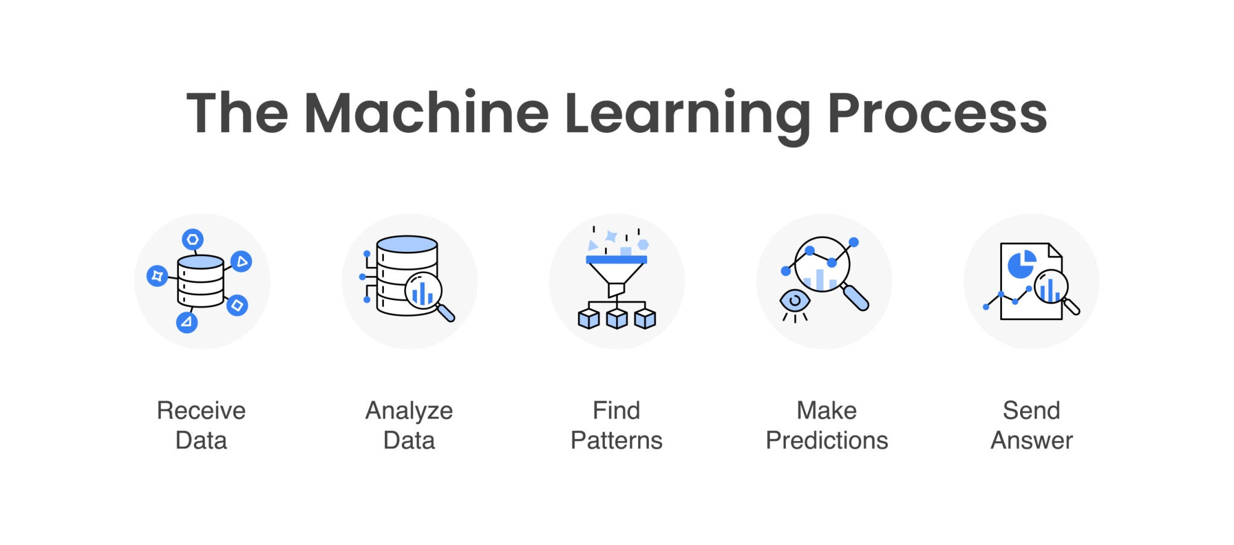
What is it ?
Machine learning (ML) is a type of artificial intelligence (AI) that teaches computers to learn from data and improve from experience, rather than being explicitly programmed for every task.
Think of the difference between a traditional calculator and a spam filter:
Traditional Programming: A calculator is programmed with explicit rules (e.g., "When you see '+', add the numbers"). It can't do anything it wasn't programmed for.
Machine Learning: A spam filter learns what spam looks like. You "train" it by showing it thousands of example emails, labeling each as "spam" or "not spam." The algorithm finds the patterns itself (e.t., weird spellings, urgent phrases, specific links) and creates its own rules. It then uses these learned rules to predict whether a new, unseen email is spam.

Slide 6
How ML Works ?
Gather Data: You collect a large amount of relevant data (e.g., images, text, numbers, sensor readings).
2) Train the Model: You feed this data to an ML algorithm. The algorithm "trains" by adjusting its internal parameters to find patterns, correlations, and structures within the data.
3) Create a Model: The output of the training process is a "model." This model is essentially a complex set of rules and patterns that the algorithm learned from the data.
4) Make Predictions: You can now give the model new, unseen data, and it will use its learned patterns to make a prediction, classification, or decision.
Refer - Main_MachineLearning.pdf

Slide 7
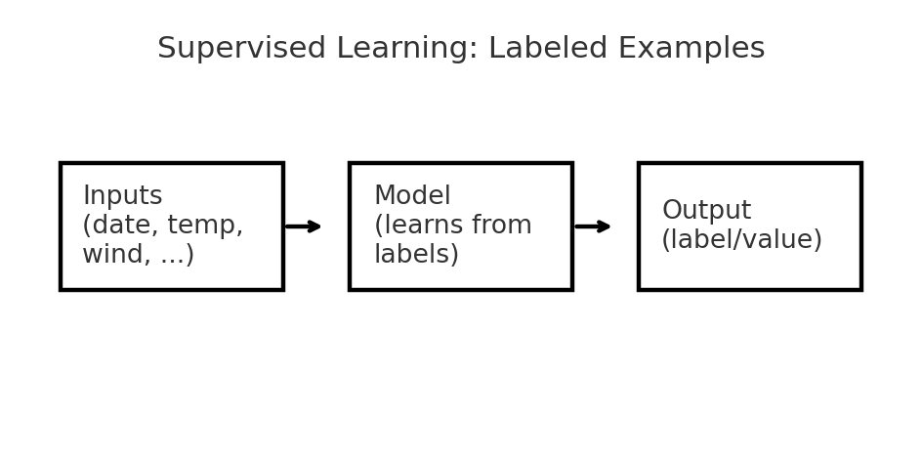
Machine Learning Types ?
1. Supervised Learning
This is like learning with a teacher or flashcards. The computer is given example data that is already labeled with the correct answer.
Analogy: You show a child thousands of pictures, each one labeled "cat" or "not a cat."
Goal: To learn a mapping from the input to the output.
Used for: risk assessment, image recognition, predictive analytics.on.
Use Cases:
Image Recognition: (Is this picture a cat or a dog?)
Spam Filtering: (Is this email spam or not spam?)
Medical Diagnosis: (Does this scan show a tumor?)

Slide 8
Main Algorithm Families

Slide 9
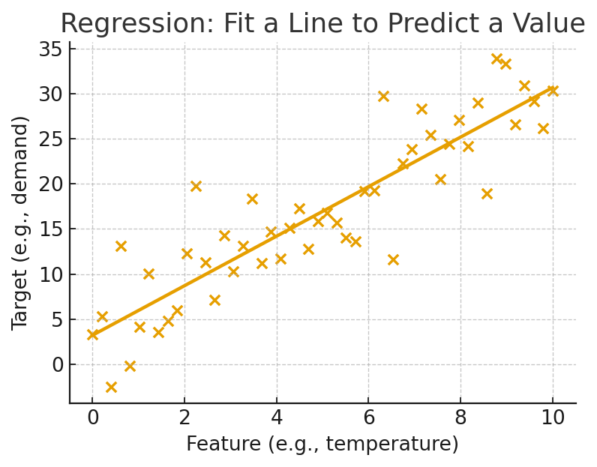
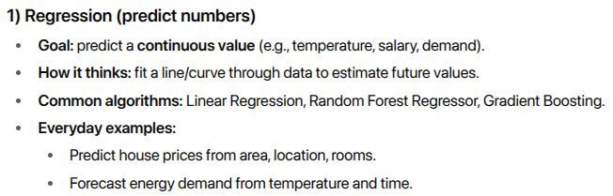
Regression

Slide 10
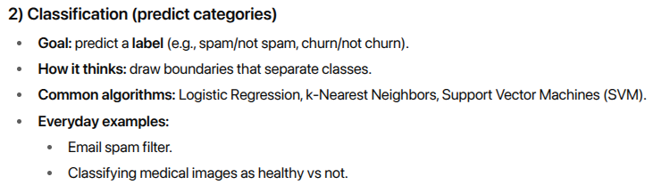
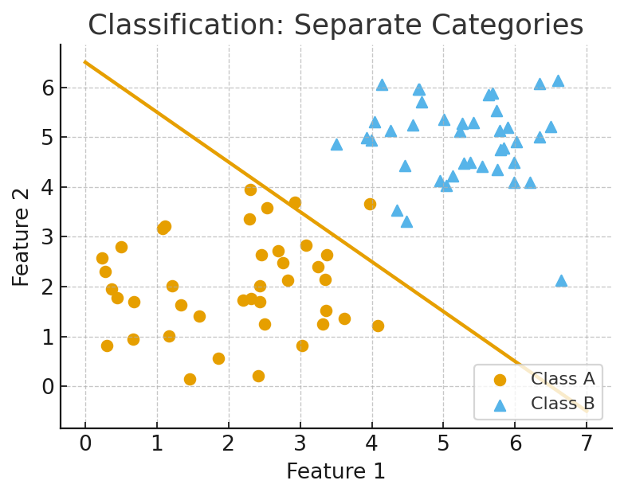
Classification

Slide 11
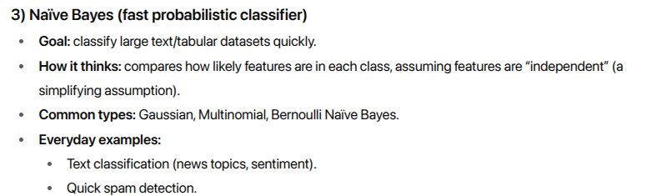
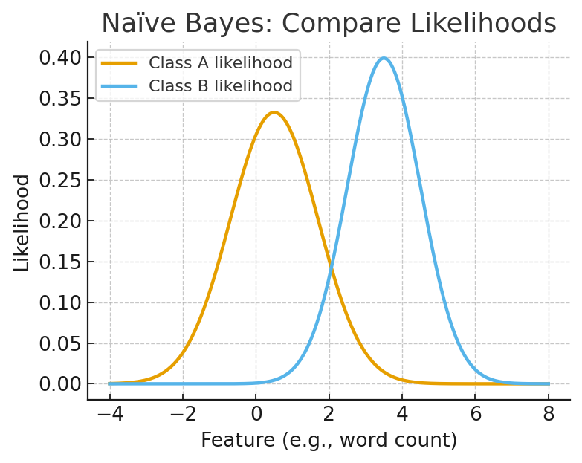
Naive Bayes

Slide 12
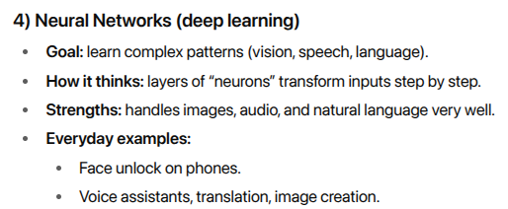
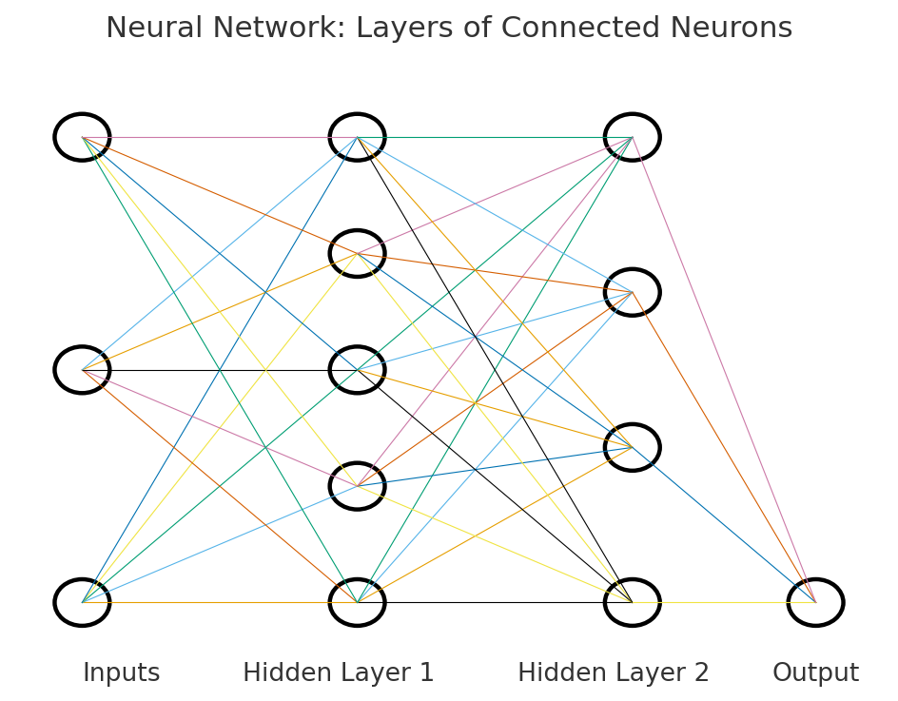
Neural Networks
Refer - Basic_neural_networks.pdf

Slide 13
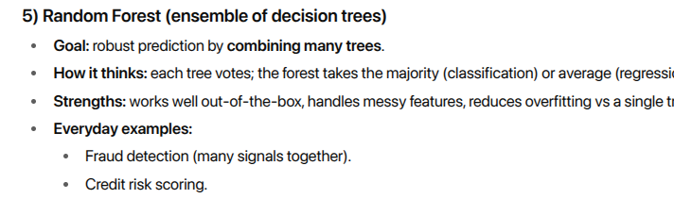
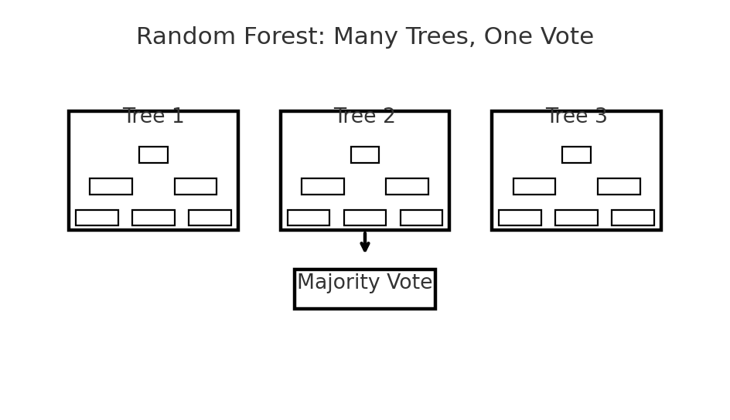
Random Forest

Slide 14
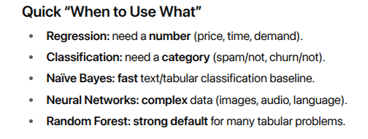
Refer - ML Concepts Explained html doc.

Slide 15
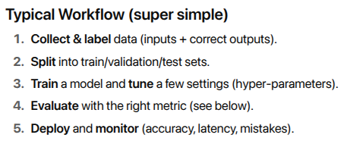
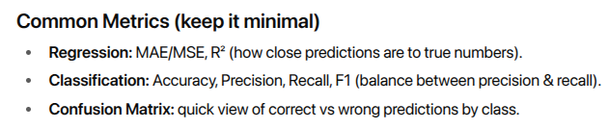
What would be the flow ?

Slide 16
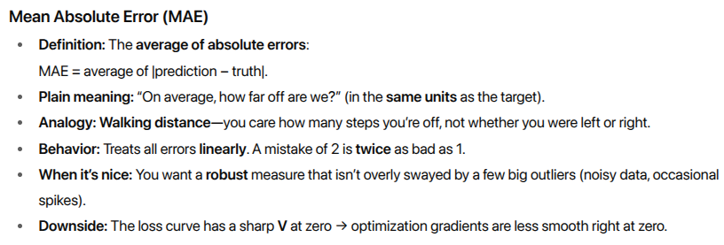
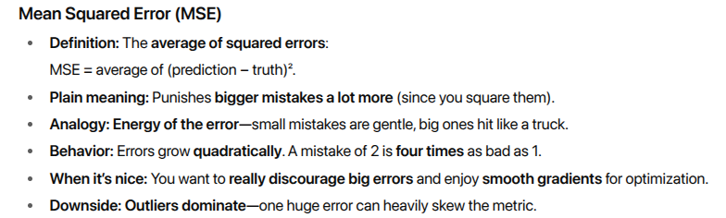
What are MAE and MSE?

Slide 17
Mean Absolute Error
Mean Absolute Error (MAE) is a simple metric used to measure the average size of errors in a set of predictions, without caring about their direction (whether they were too high or too low).
It answers the question: "On average, how far off was our prediction from the actual value?"
A lower MAE is better, with an MAE of 0 meaning the predictions are perfect.
Simple Use Case: Predicting House Prices
Imagine you're a real estate agent trying to predict house sale prices. You make three predictions:

Slide 18
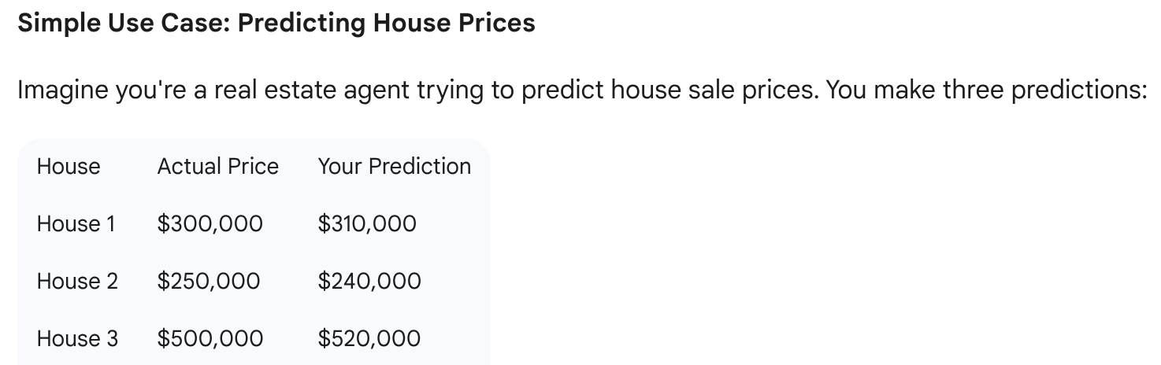
Eg

Slide 19
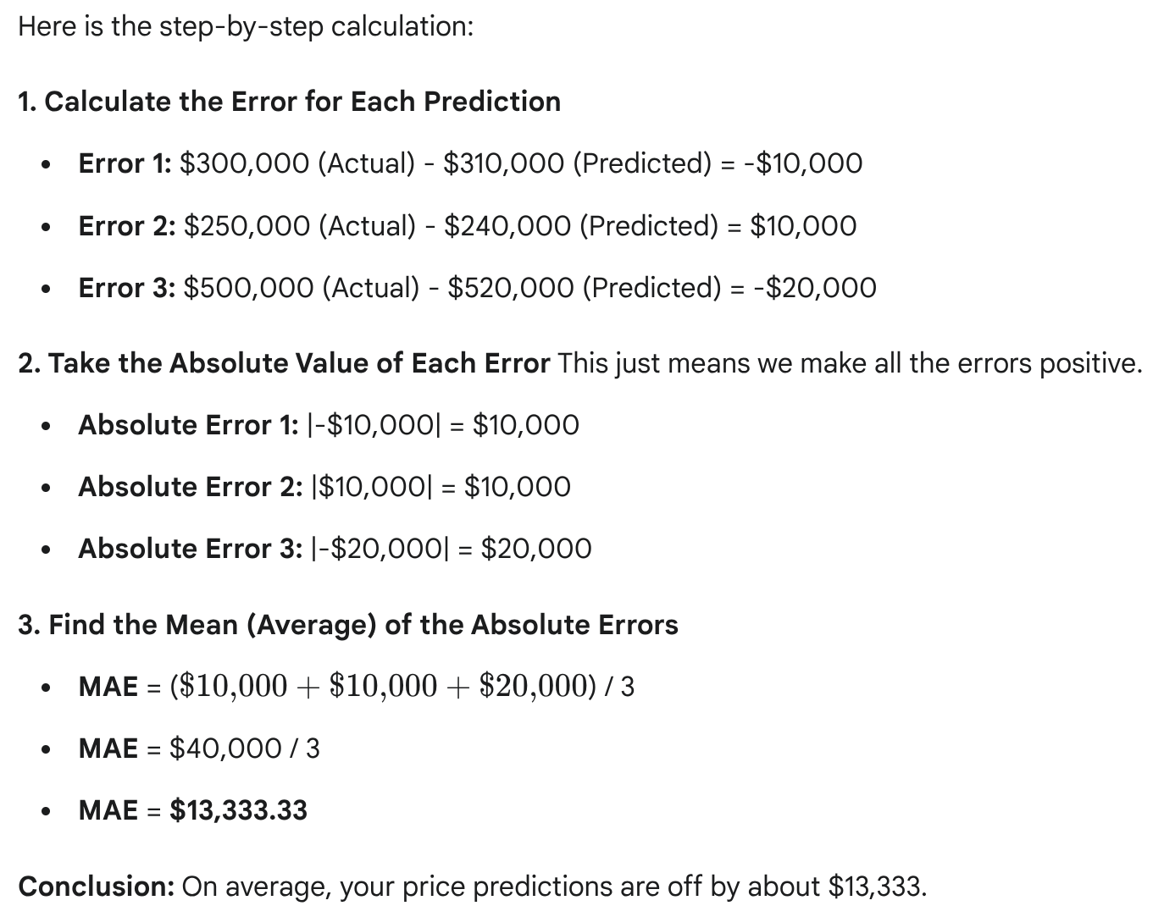
Calculation MAE

Slide 20
Mean Squared Error
Mean Squared Error (MSE) is a metric that measures the average squared difference between predicted and actual values.
It answers the question: "How close is our model's fit to the actual data?"
The key difference from Mean Absolute Error (MAE) is that MSE punishes large errors much more severely because it squares the error. A lower MSE is better.

Slide 21
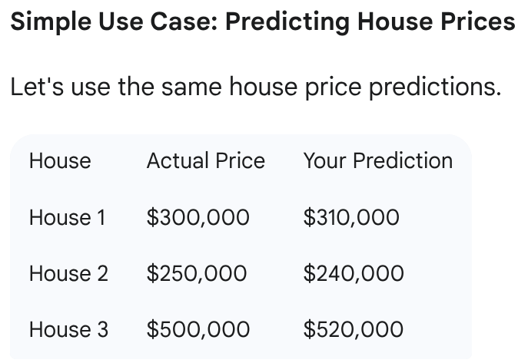
Eg

Slide 22
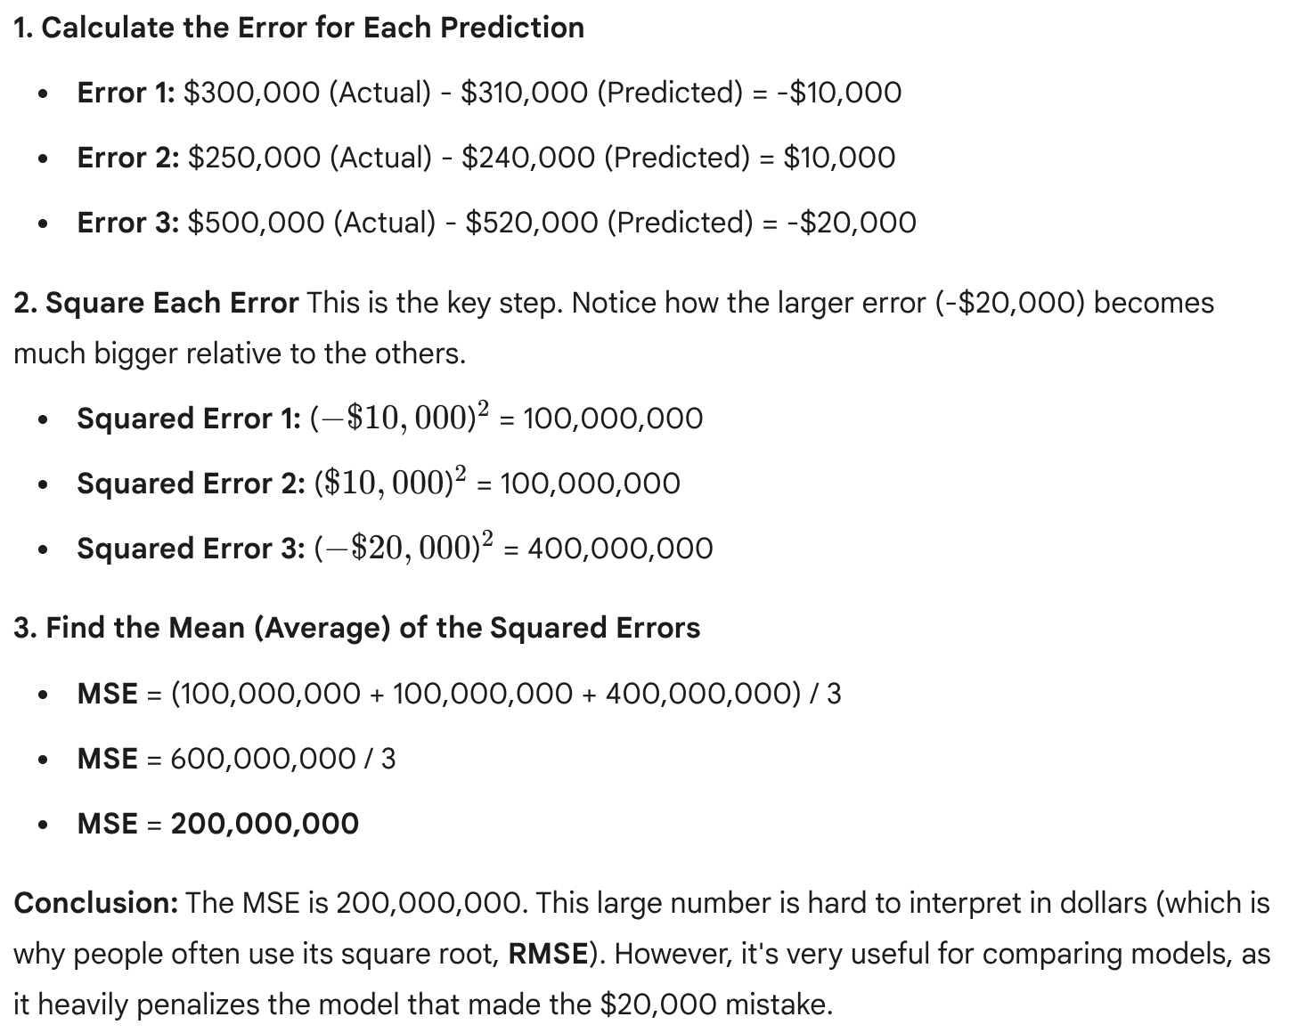
Calculating MSE

Slide 23
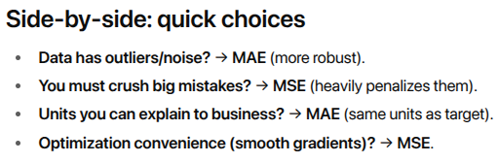

Slide 24
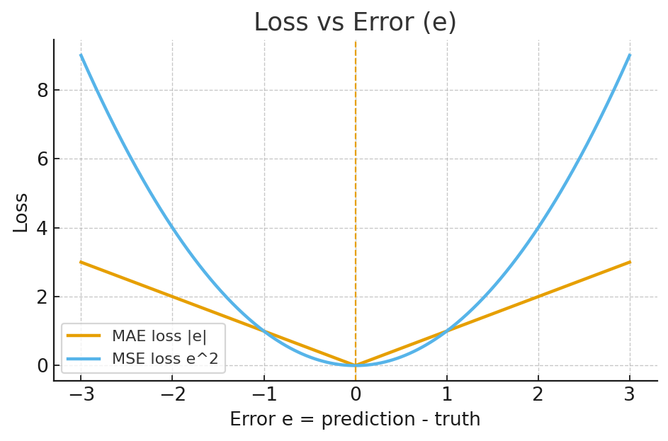
Loss curves: shows how each loss grows with error
MAE: a V-shape (linear growth).
MSE: a U-shape (quadratic growth, outliers matter more).

Slide 25
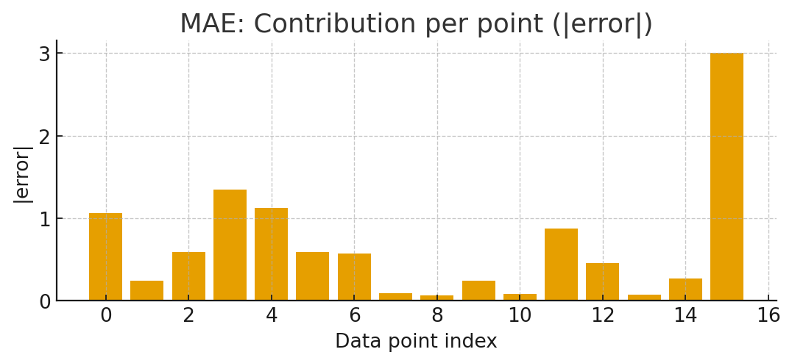
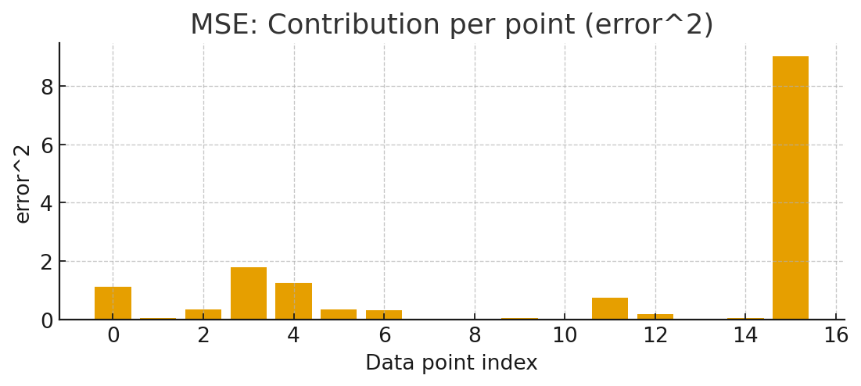
Outlier sensitivity: contribution per data point
MAE contributions (|error|):
MSE contributions (error²):
Notice how the single big outlier towers in the MSE plot,
but is more modest in the MAE plot.

Slide 26
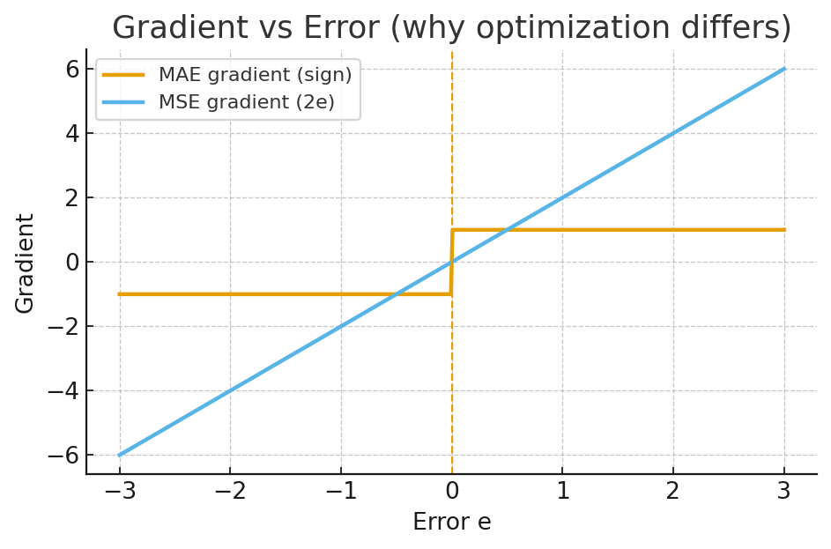
Why optimization feels different ?
MAE gradient: flat ±1 away from zero (piecewise constant).
MSE gradient: 2e (grows with error), giving strong pushback on large mistakes.

Slide 27
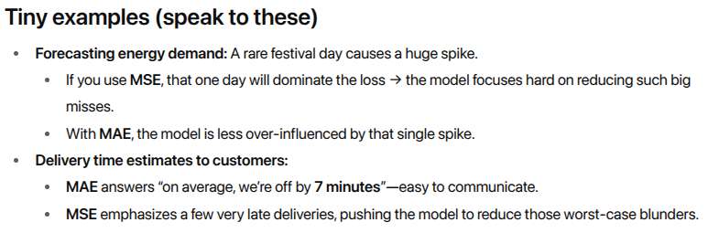

Slide 28
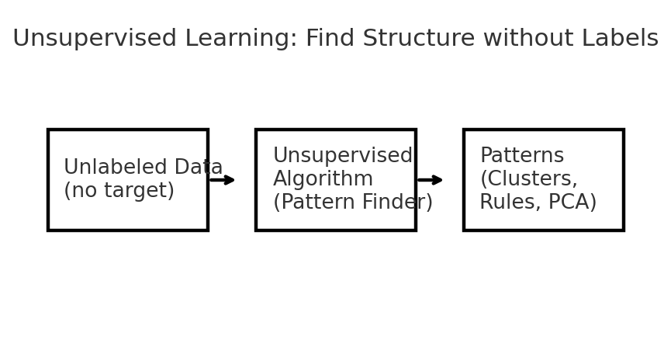
Unsupervised Machine Learning
Idea: Find hidden structure in unlabeled data (no target output).
What it helps with: exploration, pattern discovery, anomaly detection, dimensionality reduction, recommendations.
Think of it as: The model is a pattern detective—it groups similar things, finds frequent item combos, and shows the main directions of variation.

Slide 29
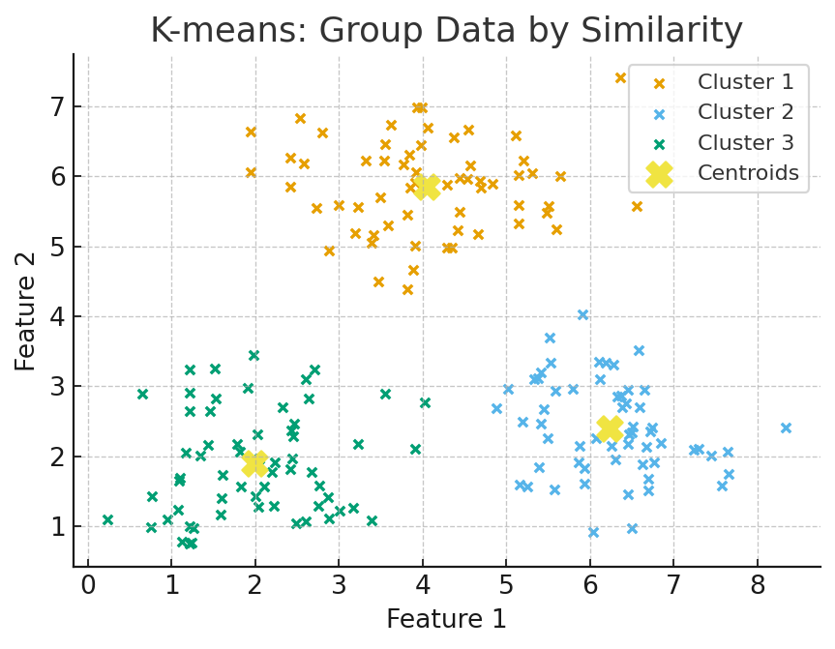
Core Methods & Where They Shine
1) Clustering (group similar items)
Goal: put data points into natural groups (no labels).
Use-cases: customer segments, anomaly detection, image grouping, document/topic grouping.
K-means clustering
How it works: pick K centers (centroids), assign points to the nearest center,
move centers to the middle, repeat.

Slide 30
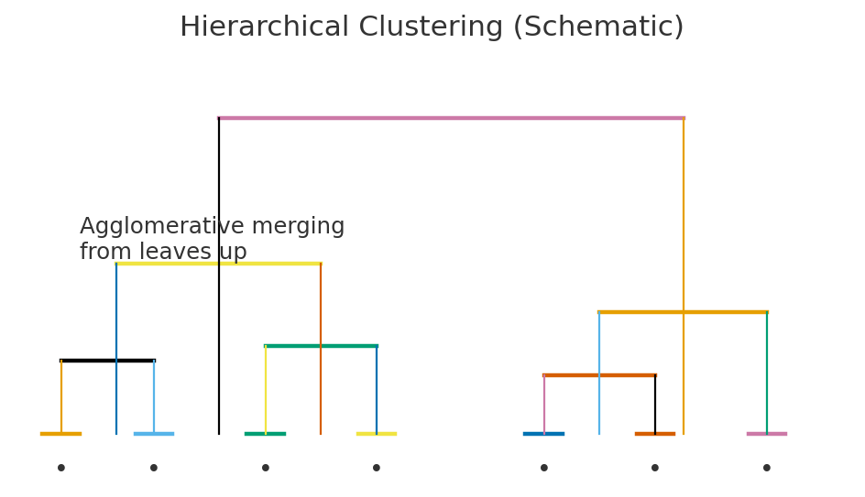
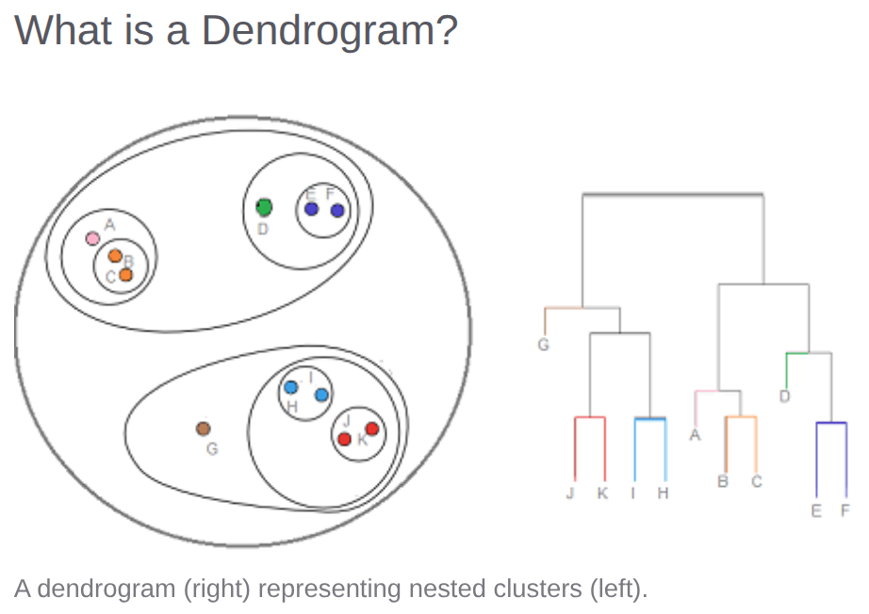
Hierarchical clustering
Hierarchical clustering is an unsupervised learning algorithm that groups similar data points into clusters. Unlike other methods (like K-Means) where you have to specify the number of clusters beforehand, hierarchical clustering builds a tree-like hierarchy of clusters.
The main output is a visualization called a dendrogram, which shows the nested grouping of data points and helps you decide on the optimal number of clusters.

Slide 31
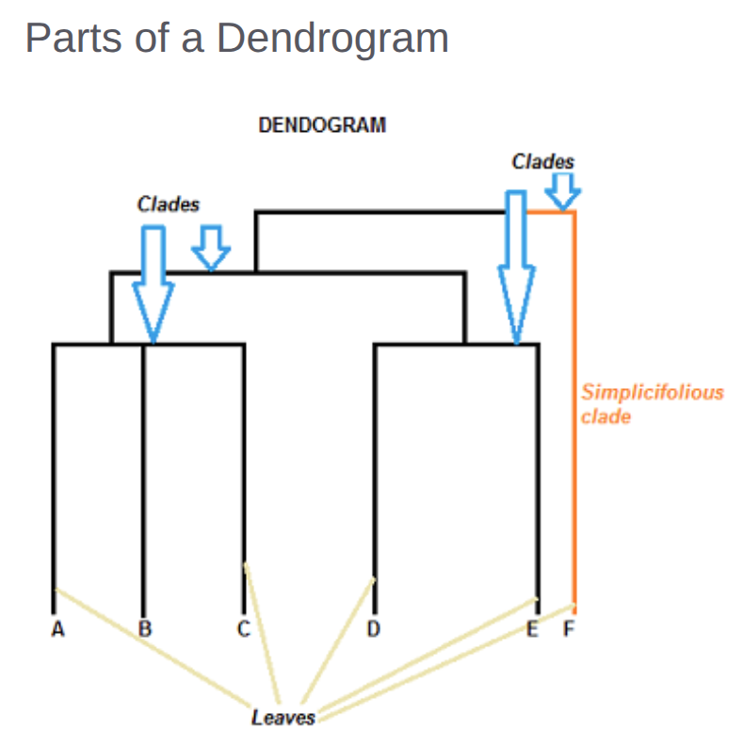
Understand Dendrogram
How to Read a Dendrogram
A dendrogram is a tree-like diagram that shows how data points are grouped together in hierarchical clustering.
Bottom (X-axis): These are your individual data points (in this example: A, B, C, D, E, F).
Vertical Lines (Y-axis): The height of the lines represents the distance or dissimilarity. The higher the line, the more different the items are.
Short vertical lines (like the one joining B and C) mean the items are very similar.
Tall vertical lines (like the one joining F to the rest) mean the clusters being joined are very different.
To understand the clusters:
You read it from the bottom up. In this image, B and C are the most similar, so they are joined first. Then D and E are joined.
To choose the number of clusters, you "cut" the tree horizontally. The number of vertical lines your cut intersects is the number of clusters.
If you cut horizontally at a Distance of 2.0, your line would cross 3 vertical lines, giving you 3 clusters:
{F}
2. {A}
3. {B, C, D, E}
Leaves A, B, and C are more similar to each other than they are to leaves D, E, or F.
Leaves D and E are more similar to each other than they are to leaves A, B, C, or F.
Leaf F is substantially different from all of the other leaves.

Slide 32
Types of Hierarchical Clustering
1. Agglomerative (Bottom-Up)
This is the most common approach. It works by treating each data point as its own individual cluster and then progressively merging the closest pairs of clusters until only one large cluster (containing all data points) remains.
The process is:
Start: Every data point is its own cluster. If you have N data points, you have N clusters.
2. Find Closest Pair: Calculate the distance between all pairs of clusters.
3. Merge: Combine the two "closest" clusters into a single new cluster.
4. Repeat: Repeat steps 2 and 3 until all data points are merged into one single cluster.

Slide 33
Types of Hierarchical Clustering
2. Divisive (Top-Down)
This approach is the opposite of agglomerative. It starts with all data points in a single, large cluster and then recursively splits them into smaller clusters.
The process is:
Start: All data points are in one single cluster.
2. Split: Divide the cluster into two new clusters that are most dissimilar.
3. Repeat: Repeat step 2 on the new clusters until every data point is in its own cluster.
Agglomerative is used more frequently in practice due to its computational simplicity.

Slide 34
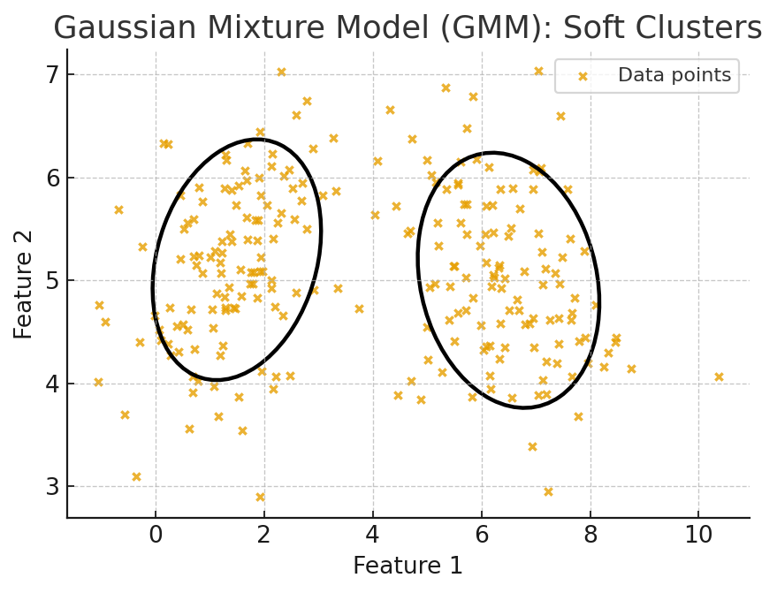
Probabilistic / Density-based (e.g., GMM)
How it works: assume data comes from a mix of Gaussian blobs; each point has a soft membership to clusters.
Where it fits: overlapping clusters, soft assignments, density estimation.

Slide 35
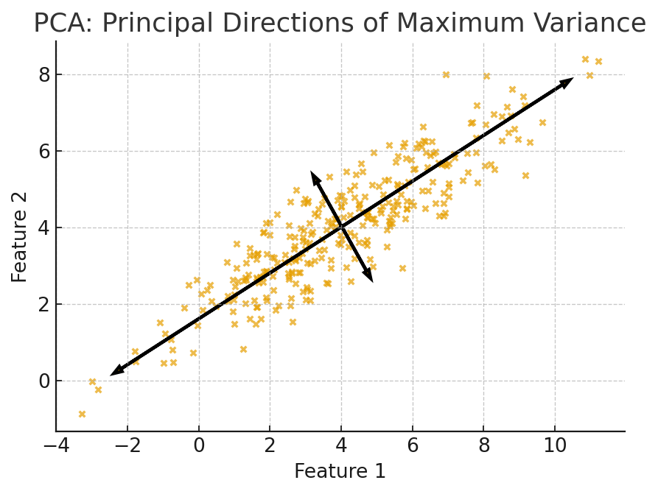
2) Dimensionality Reduction (summarize / visualize)
PCA (Principal Component Analysis)
Idea: rotate/transform data to new axes that capture most variance.
Why: simplify features, remove noise, visualize high-dim data in 2D/3D, speed up models.

Slide 36
PCA – principal component analysis
Principal Component Analysis (PCA) is a dimensionality reduction technique. Its main goal is to reduce the number of features (or dimensions) in a large dataset while losing as little information as possible.
It works by transforming the original, often correlated, features into a new set of uncorrelated features called principal components.
These new components are ordered by how much of the original data's variance (i.e., information) they capture. The first principal component (PC1) captures the most variance, the second (PC2) captures the second most, and so on.
You can then keep only the first few principal components (e.g., PC1 and PC2) and discard the rest, giving you a much smaller dataset that still retains most of the important patterns.

Slide 37
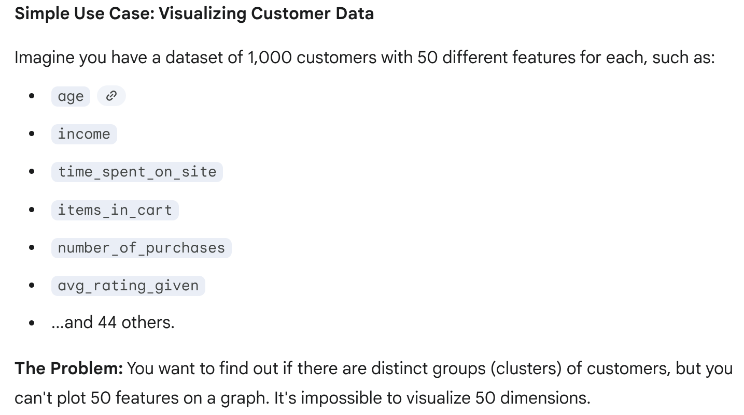
Eg

Slide 38
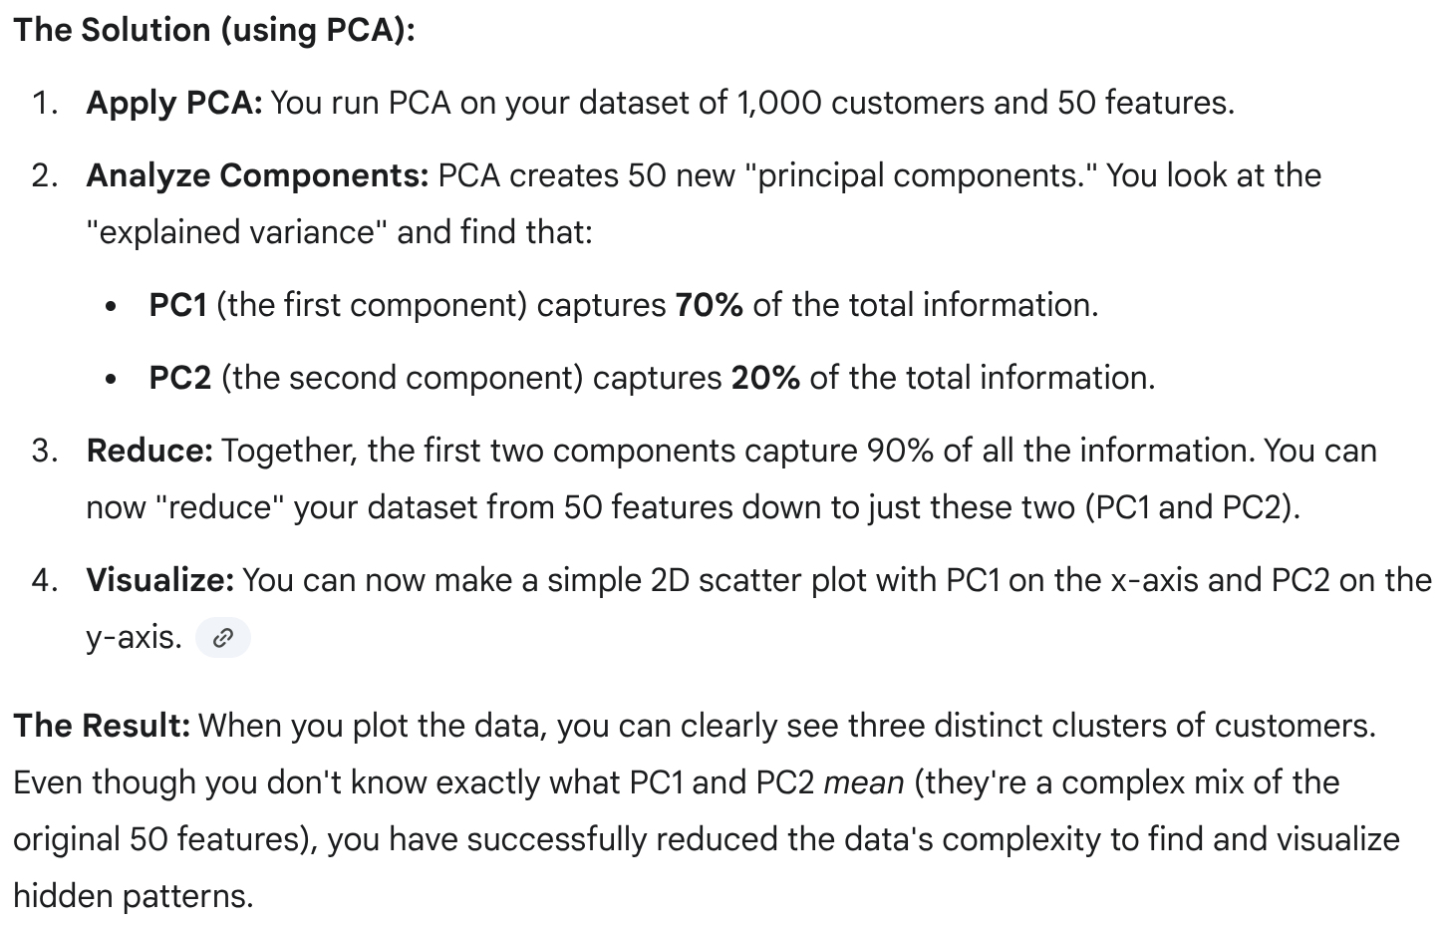

Slide 39
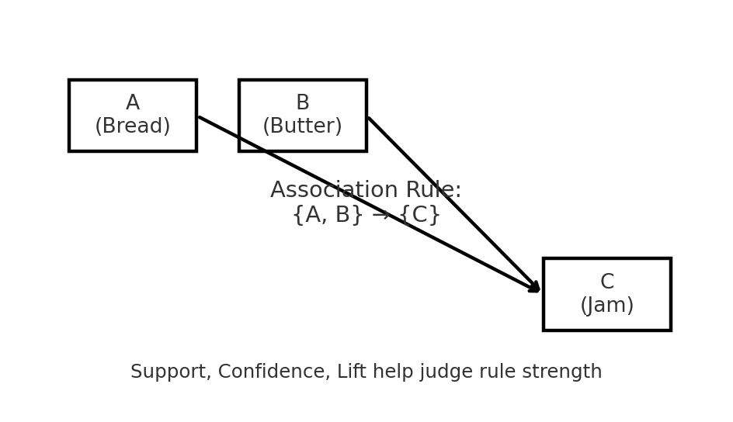
3) Association Rules (find “go together” items)
Idea: discover items/events that often occur together (e.g., market baskets).
Famous example: Apriori algorithm.
Metrics: Support (how common), Confidence (how often rule holds), Lift (how much better than chance).
Use-cases: “Customers who bought A & B also buy C”, cross-selling, UX bundling.
Apriori algorithm is a data mining technique used to find frequent patterns, correlations, or "association rules" in large datasets.
It's most famous for Market Basket Analysis, which tries to find items that are frequently purchased together.
The core idea is based on the Apriori property:
If an itemset (e.g., {Bread, Milk}) is frequent...
...then all of its subsets (e.g., {Bread} and {Milk}) must also be frequent. Conversely, if a subset (e.g., {Eggs}) is infrequent, then any larger set containing it (e.g., {Eggs, Milk}) must also be infrequent, and we can ignore it. This rule drastically speeds up the search.

Slide 40
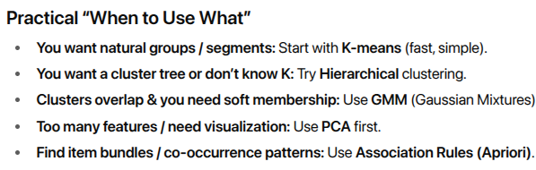

Slide 41
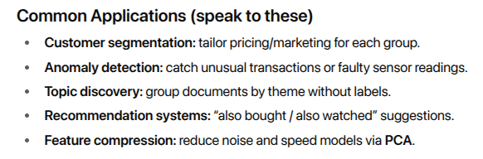
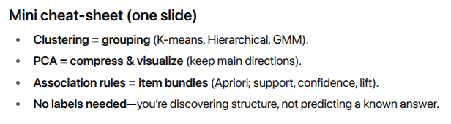

Slide 42
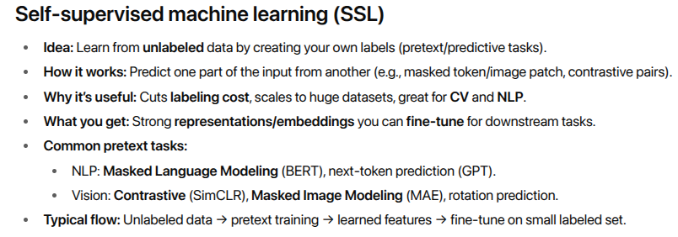

Slide 43
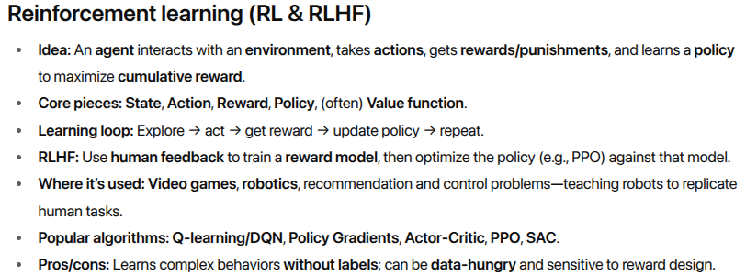

Slide 44
Semi-supervised learning

Slide 45
Semi-supervised learning
What it is: A mix of supervised (needs labels) and unsupervised (no labels) learning.
Key idea: Use a small set of labeled data plus a large set of unlabeled data. The few labels act like “hints” to guide learning from the big unlabeled pile.
How it works (typical flow):
Start with, say, 200 labeled images and 20,000 unlabeled images.
Use unsupervised steps to group/cluster similar data.
Use the labeled examples to name/guide those groups.
The model then learns patterns from all data, getting better than using only 200 labels.

Slide 46
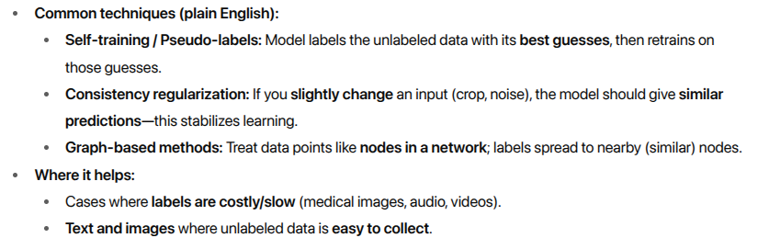

Slide 47
What are machine learning algorithms?

Slide 48
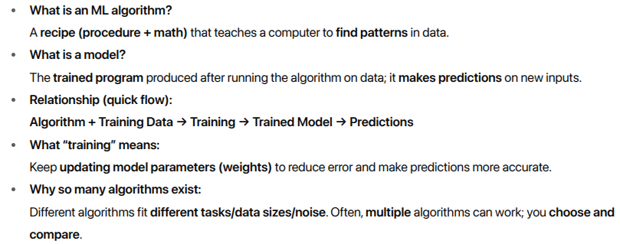
Machine Learning Algorithms

Slide 49
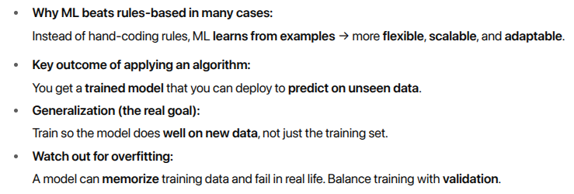

Slide 50
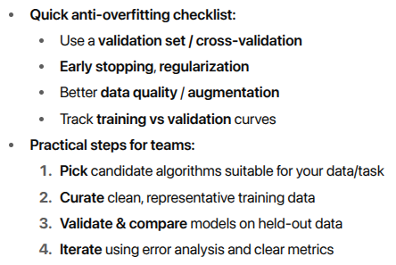

Slide 51
Types of Machine Learning Algorithms

Slide 52
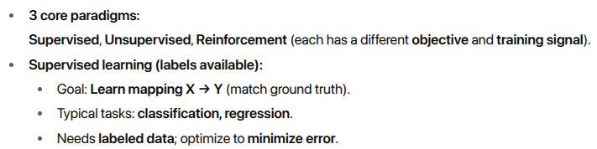
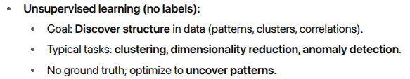
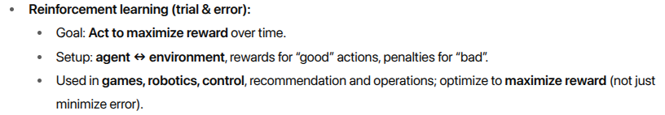

Slide 53
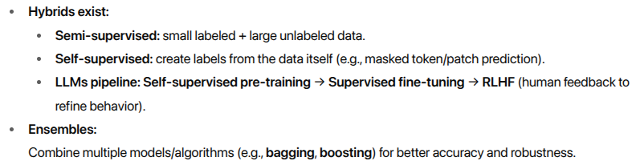


Slide 54
Supervised learning
Core idea :
Learn from labeled examples so the model’s predictions match ground truth; keep adjusting parameters to minimize loss.
What “supervised” means:
You provide inputs (X) and correct answers (Y labels). The model predicts ŷ, a loss function compares ŷ vs Y, and optimization tweaks the model to reduce that loss.

Slide 55



Slide 56



Slide 57


Slide 58

Common Regression algorithms

Slide 59

Common Regression algorithms

Slide 60

Common Regression algorithms

Slide 61


Slide 62

Common classification algorithms

Slide 63

Common classification algorithms

Slide 64

Common classification algorithms

Slide 65

Common classification algorithms

Slide 66


Practical tips

Slide 67


Self-supervised learning

Slide 68


Self-supervised learning

Slide 69

Self-supervised learning

Slide 70
Unsupervised learning algorithms

Slide 71
Unsupervised Learning
What it is (one line):
Learn patterns and structure from unlabeled data—no “right answer” labels, just the data itself.
When to use:
You don’t know the ideal output in advance.
You want to group similar items, find anomalies, or simplify high-dimensional data.

Slide 72
Unsupervised Learning
How it works (simple view):
No teacher/labels. Algorithms look for natural groupings, co-occurring items, or compact low-dimensional summaries of the data.
(Note: there isn’t ground-truth supervision; many methods still optimize an internal objective, e.g., “tight clusters” or “max variance.”)

Slide 73

Unsupervised Learning
Gaussian mixture models (GMMs)
DBSCAN (Density-Based Spatial Clustering Applications with Noise)

Slide 74

Unsupervised Learning

Slide 75
Semi-supervised learning algorithms

Slide 76

Semi-supervised learning algorithms

Slide 77

Semi-supervised learning algorithms

Slide 78

Semi-supervised learning algorithms

Slide 79


Semi-supervised learning algorithms
Quick workflow

Slide 80
Reinforcement learning algorithms

Slide 81


Reinforcement learning algorithms

Slide 82

Reinforcement learning algorithms

Slide 83

Reinforcement learning algorithms

Slide 84


Slide 85
Ensemble learning algorithms

Slide 86
Ensemble learning
What & why
Combine multiple models (“learners”) so the ensemble is more accurate, stable, and robust than any single model.
Core benefits
Higher accuracy: different models cover each other’s mistakes.
b) Lower variance/overfitting: averaging/voting smooths noisy predictions.
c) Reliability: works well when data is messy or decision boundary is complex.

Slide 87


Slide 88


Slide 89

LAB - ml_demo_01

Slide 90
Deep Learning

Slide 91
Deep learning is a subset of machine learning driven by multilayered neural network whose design is inspired by the structure of the human brain.
Deep learning models power most state-of-the-art today, from computer vision and generative Ai to self-driving cars and robotics.

Slide 92


Deep neural network structure

Slide 93

Deep Learning - Terms
Core Components 🧱

Slide 94


Slide 95

Deep Learning - Terms
Core Components 🧱

Slide 96

Deep Learning Models

Slide 97

Deep Learning Models

Slide 98


Deep Learning Models

Slide 99

Deep Learning Models
LSTM (Long Short-Term Memory)
GRU (Gated Recurrent Unit)

Slide 100

Deep Learning Models

Slide 101

Deep Learning Models

Slide 102

Deep Learning - Use cases

Slide 103

A Case

Slide 104


Problem is ...
XOR (exclusive OR) function maps two binary inputs to an output of 1 if the inputs differ, and 0 if they are the same.
This simple rule exposes a foundational limitation in early neural network architectures and marks a turning point in the field’s evolution.
When plotted in two-dimensional input space, the outputs of the XOR function cannot be separated by a single straight line,
Whereas functions such as AND or OR can be.
This property, known as non-linear separability, places XOR outside the representational capacity of a single-layer perceptron.

Slide 105



This chart clearly visualizes the failure of straight lines to separate the XOR classes. The points representing output 1 ((0,1), (1,0)) and output 0 ((0,0), (1,1)) are color-coded, and several candidate decision lines are shown, none of which fully separate the classes.
This illustrates why the XOR problem cannot be solved with a single linear boundary and requires nonlinear models.

Slide 106



Slide 107

Lab -
files_NN_demo_01.zip
2) files_Deep_NN_demo_02.tgz

Slide 108
GenAI & LLMs: Beyond the Magic Box! 🪄
Decoding the Digital Minds that are Changing Our World

Slide 109

What is Generative AI? (GenAI)
GenAI = AI that creates something new!
Traditional AI: Sees a picture, tells you it's a "cat." (Recognizes)
Generative AI: You ask it for "a cat wearing a spacesuit on Mars," and it draws it for you! (Creates)

Slide 110

What is a generative model?
A generative model is a model designed to create new data that is similar to its training data.
Generative models learn the patterns and distributions of the training data, then apply those understandings to generate novel content in response to new input data.

Slide 111


Slide 112


Slide 113


Slide 114



Slide 115


Slide 116


Slide 117


Slide 118


Slide 119


Slide 120


Slide 121


Slide 122
Quiz Time
Which statement best captures what sets Generative AI apart from other AI types?
A. It only classifies existing data more accurately B. It retrieves facts from a database without alteration C. It creates novel outputs that resemble training distributions D. It compresses datasets for faster storage
2) Match the architecture to its strongest typical use:
A. Transformers → Image denoising B. Diffusion models → Step-by-step denoising to synthesize images/video C. GANs → Long-context text generation D. VAEs → Strict rule-based classification
3) Which combo is MOST aligned with responsible GenAI deployment? A. Bigger models + higher temperature B. RLHF/DPO + data governance + human-in-the-loop C. Zero-shot prompting only D. Disable logs to protect privacy
Answer: C
Why: Generative models produce new content, not just classify/retrieve.
Answer: B
Why: Diffusion models generate media by iterative denoising; Transformers dominate text/code
Answer: B
Why: Alignment + governance + review are key guardrails for trustworthy systems.

Slide 123

How do generative models work?

Slide 124

Gen Models working

Slide 125

Gen Models working

Slide 126



Gen Models working
What the “loss” is

Slide 127


Gen Models working

Slide 128

Gen Models working

Slide 129
Generative models
versus
other model types

Slide 130

Model Types at a Glance

Slide 131

Generative Models (Create)

Slide 132

Discriminative Models (Decide)

Slide 133

Clustering Models (Discover)

Slide 134

Predictive Models (Forecast)

Slide 135

Generative vs Discriminative (Key Contrast)

Slide 136

Why discriminative models use labels ?

Slide 137

Why discriminative models use labels ?

Slide 138
Why discriminative models must use labels (summary)
Goal: learn P(y|x) / decision boundary between classes.
To know if a boundary is good, you need ground truth y.
Unlabeled data alone only gives structure of x, not the mapping x \to y.
Therefore:
Pure discriminative training is inherently supervised.
Unlabeled data can help (semi-/self-supervised), but you still need some labels to tie everything to real classes.

Slide 139

When to Use What

Slide 140


Simple Examples to Remember
Cheat Sheet (1-liner each)

Slide 141
Types of generative models

Slide 142

Autoregressive Models
2) Diffusion models
3) Generative adversarial networks (GANs)
4) Variational autoencoders (VAEs)
5) Flow-Based models

Slide 143

Autoregressive Models

Slide 144

Autoregressive Models

Slide 145

Autoregressive Models

Slide 146

Use Cases

Slide 147

Transformer Models

Slide 148

Transformer Models

Slide 149


Transformer Models

Slide 150


Transformer Models

